Slide 1

VERVE - a proposal for an ESA mini-Fast mission to Venus
Jane Greaves (Cardiff University)
for the VERVE team

Slide 2

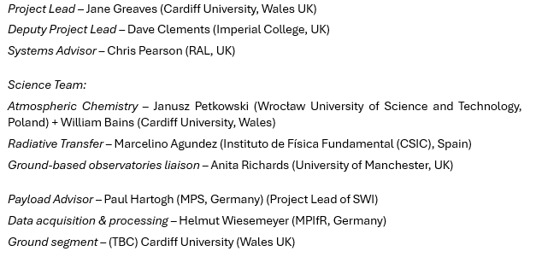
what is it? – a submillimetre spectrometer scanning Venus for out-of-equilibrium gases – one origin of which could be life

Slide 3
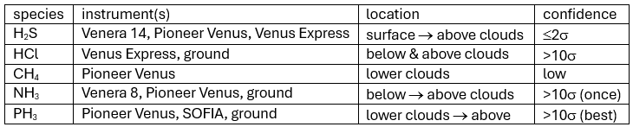
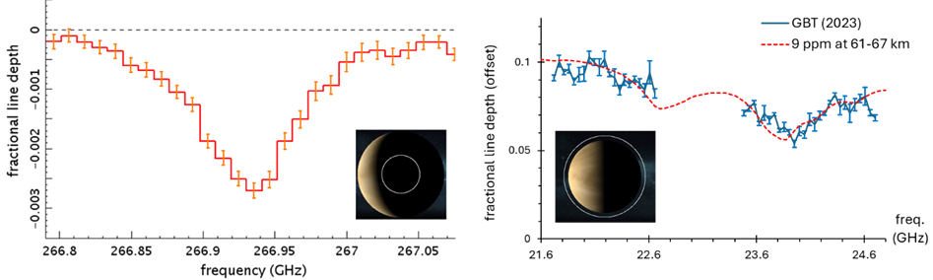
target gases
GBT, SRT
JCMT, ALMA
phosphine, PH₃
ammonia, NH₃

Slide 4
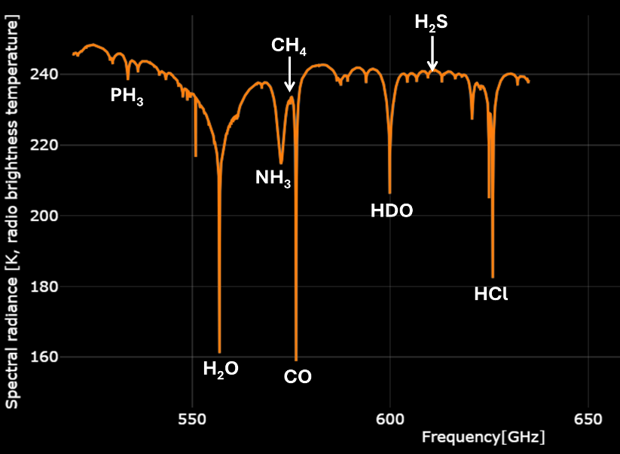
why the submillimetre?
a single band at ~520-640 GHz includes all the species of interest
expecting less model-sensitive results than IR
builds on legacy of ISO, Herschel for Jupiter, Saturn…

Slide 5
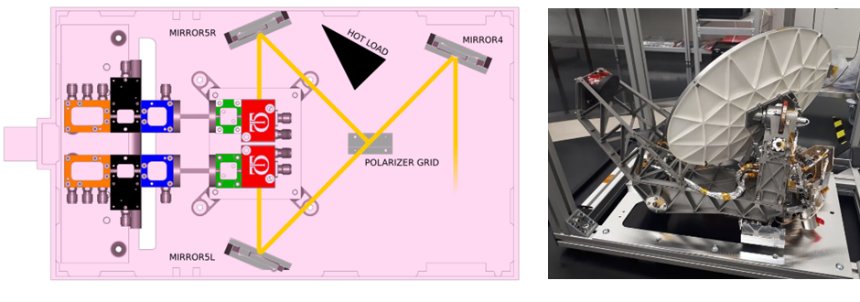

how to do rapid response science?
instrument: single-band version of SWI on JUICE going to Jupiter system

Slide 6
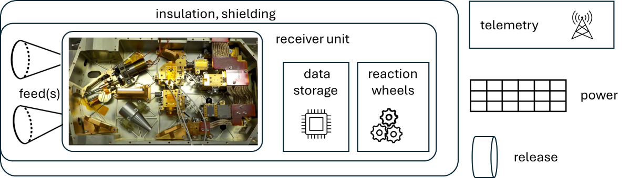
concept
feedhorn with ~0.1º FOV, scans continuously in nadir direction
auto-correlation spectrometer (δν ~10 MHz), single sideband filter
uncooled (T_{sys} ~2000 K)
image: Teratech

Slide 7
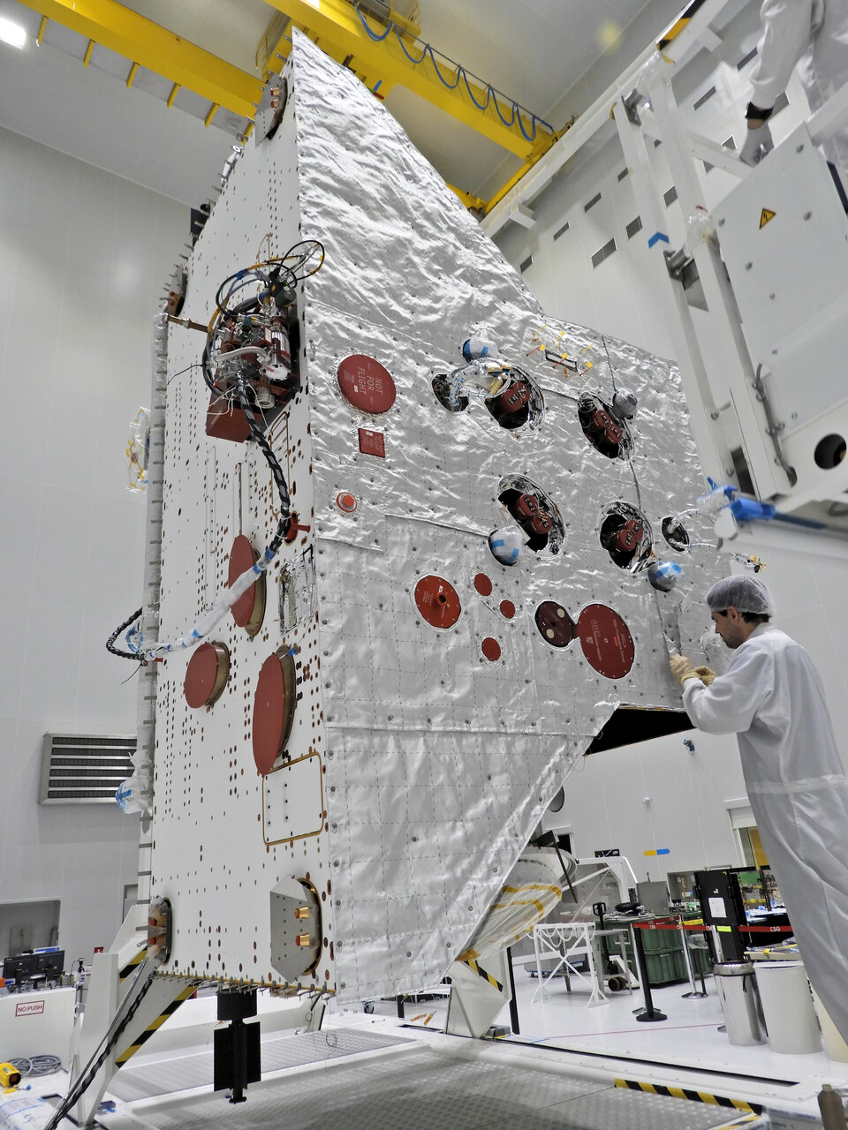
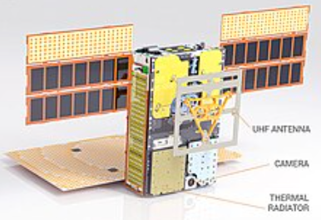
challenges?
power, comms, pointing: seem fine
data rate: low
radiation shielding – likely OK, standard for interplanetary
high temperature insulation system – similar to BepiColumbo? unclear how it scales down to small spacecraft
platform – TBD, depends on total mass – low-end estimate is ~20 kg (6-8U), similar to Mars Cube One
NASA/JPL-Caltech
ESA

Slide 8
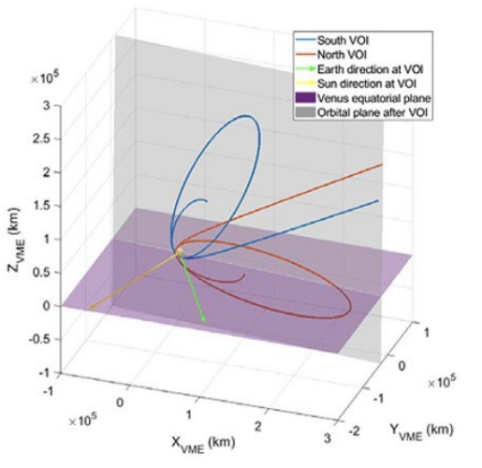


mission design
launch with Envision on Ariane 64 in November 2031, arrive mid-2033
separate before EnVision aerobraking commences, leaveing VERVE in very elliptical orbit
good for scanning range of planet scales (minimum 30 pixels across Venus)

Slide 9
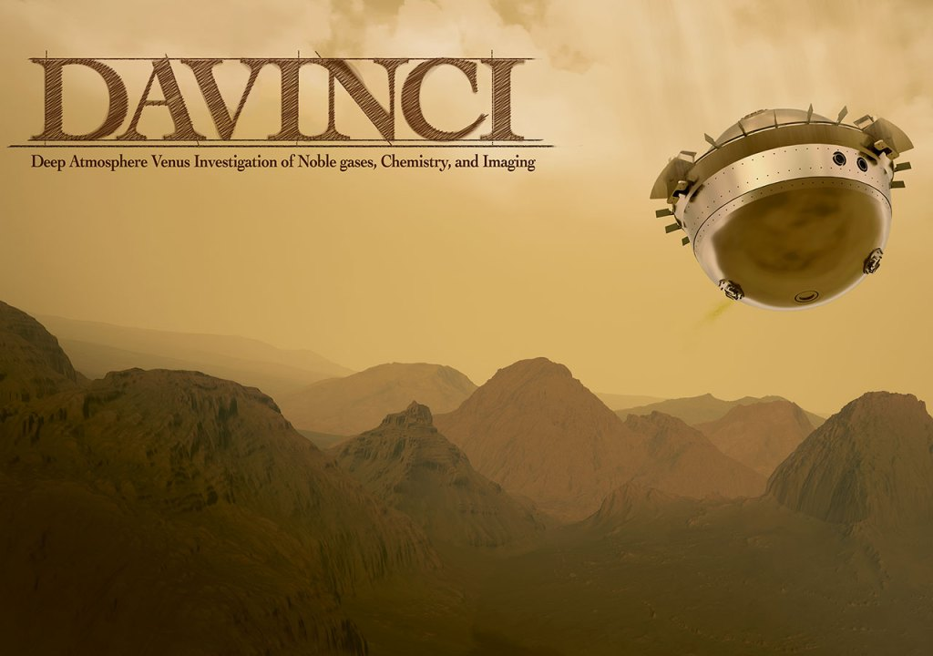
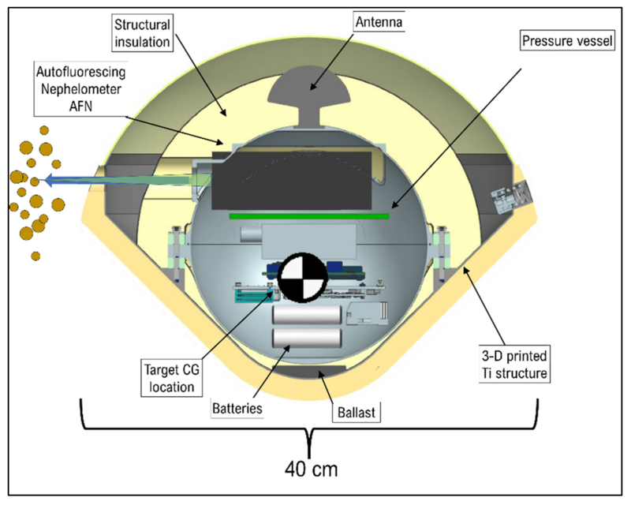
conclusions
EnVision is at advanced stage – VERVE can’t add risk!
  designing VERVE for very low data-rate link through EnVision; minimal mass (comparable to uncertainty in propellant mass of EnVision)
mission responding to science developments since 2020
VERVE can do unique science
  complements efforts at life-detection with Venus probes
???
Venus Life Finder
RocketLab

